Slide 1
Adapting NWP codes to Accelerators at NCEP: Early Status
John Michalakes
¹ NOAA Affiliate
Environmental Modeling Center
National Centers for Environmental Prediction
NCEP Seminar
6 December 2013

Slide 2
Up front...
Terms:
“Accelerators”
MIC, (Xeon) Phi, Knight’s Corner, KNC
Host, CPU, Xeon, Sandybridge, SNB
Apologize in advance for getting low-level and technical

Slide 3
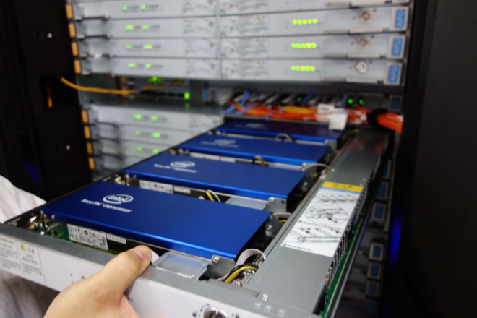
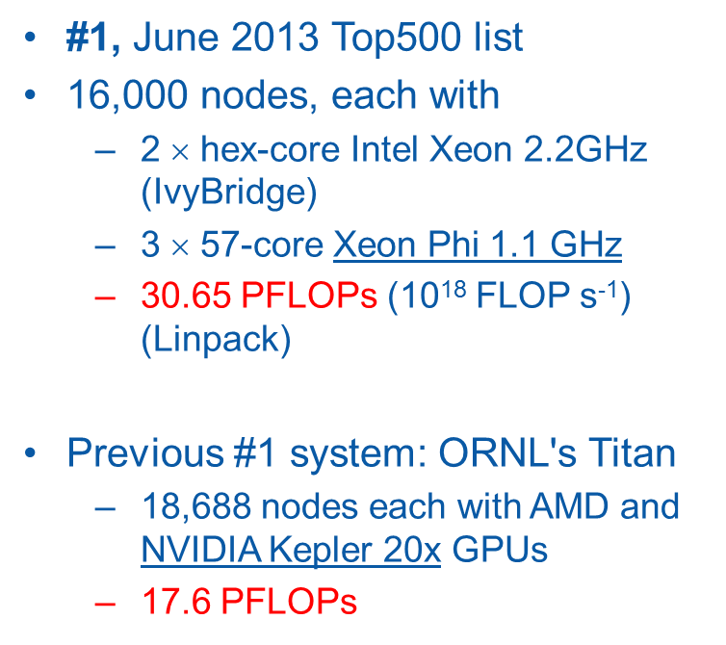
Many Integrated Core (MIC)
Intel’s “Accelerator”
Peak Teraflop “Cluster on Chip”
61 Intel x86 CPUs (cores) at 1.28 GHz
Programmed like a cluster: Fortran/C/C++, MPI and OpenMP
Application requirements for performance
Large scale O(100)-way concurrency
Vectorizable code
Good operational intensity
Intel Phi's (KNC) in drawer of TH-2

Slide 4
Many Integrated Core (MIC)
Peak performance requires that every arithmetic unit (ALU) on every core completes a fused multiply-add (FMA) on every clock cycle
There are at least as many pieces of work as ALUs (enough parallelism in the first place)
All time spent accessing memory is hidden so no ALU ever stalls waiting for an operand
All ALUs have exactly the same amount of work and never wait for one another
Potential bottlenecks
Not enough thread parallelism exposed
Not enough vector (fine-grained) parallelism exposed
Memory system can’t keep up with ALUs

Slide 5
Objectives
Accelerate the NMMB as a proof of concept
Develop best practices for modeling suite
Performance
Uncover and exploit thread parallelism (OpenMP)
Uncover and exploit fine-grained parallelism (Vector)
Reduce working set and memory system pressure
Portability, maintainability
Position operational codes for the node architectures expected in the 3-5 year time frame
Solvers and physics (including chemistry)
Nesting
Coupling

Slide 6
Methodology
Establish workloads that are representative in terms of overall cost, cost distribution, and resource footprint
Generate performance baselines
Measurement
Quantify relative performance of MIC and host
Identify opportunities for improvement, hotspots
Zero in on bottlenecks and remedies
Optimize and evaluate in terms of
Performance realized
Impact on code base
Effect of changes on host processor

Slide 7
NMMB progress
September
Branch from NMMB trunk created or Xeon Phi development
Port of NEMS/NMMB, ESMF, and NCEP LIBS to Intel Xeon Phi
October
Baseline performance using NMM_REG_CTL workload
Tiling version of NMMB implemented and tested
November
Baseline performance using 4km CONUS workloads
Optimization of RRTM radiation underway

Slide 8
Port of NMMB to MIC
SVN branch from trunk revision 31482, Sep. 27, 2013
https://svnemc.ncep.noaa.gov/projects/nems/branches/michalakes/nems-mic
– also –
https://svnemc.ncep.noaa.gov/projects/nems/branches/michalakes/esmf-mic
https://svnemc.ncep.noaa.gov/projects/nems/branches/michalakes/NEMS+LIBS_r19677
How to compile for MIC
./esmf_version host-mic (host is tacc and savoy right now)
Uses configure.nems.tacc.ifort or configure.nems.tacc.ifort-mic
source scripts to set correct ESMF_DIR, ESMF_COM, etc.
make –j 8 nmm (parallel build), then make nmm
See also initial porting document:
https://svnemc.ncep.noaa.gov/projects/nems/branches/michalakes/nems-mic/Port%20of%20NEMS%2020130917.pdf

Slide 9
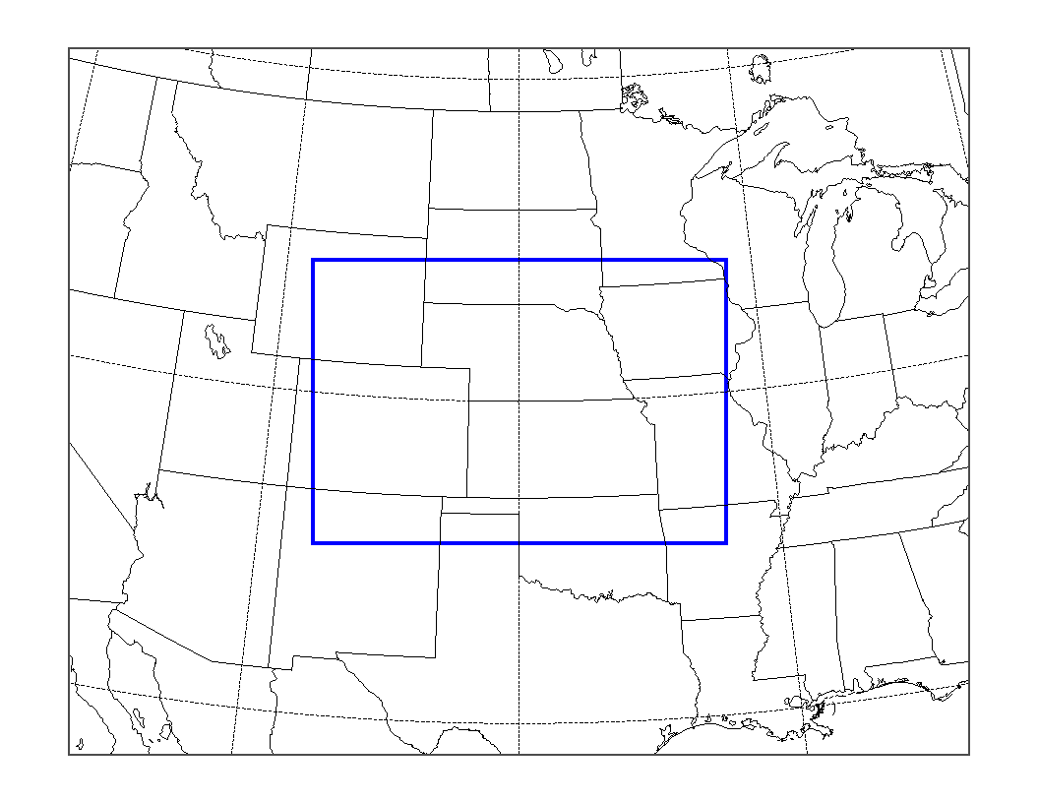
4km NMMB Workload
Sized and configured to represent workload seen by one node
From 4km CONUS nest running on 80 nodes (1280 tasks)
1. 153x123x60 (1.13 million points, 470 GF/hr) (1X)
2. 307x246x60 (4.5 million points, 1880 GF/hr) (4X)
Fundamental time step = 8.889s
20m interval for RRTM lw/sw
45s interval for land/turb/conv/mp
Thanks: Tom Black & Ratko Vasic
Test platform
Dual 8-core E5-2670 2.6 GHz SandyBridge (SNB)
1 Knight’s Corner C0-7120, 61-core 1.238 GHz, 16 GB GDDR5
Code is run “Native” mode on KNC – that is, all on the device
subdomain on 1 node

Slide 10
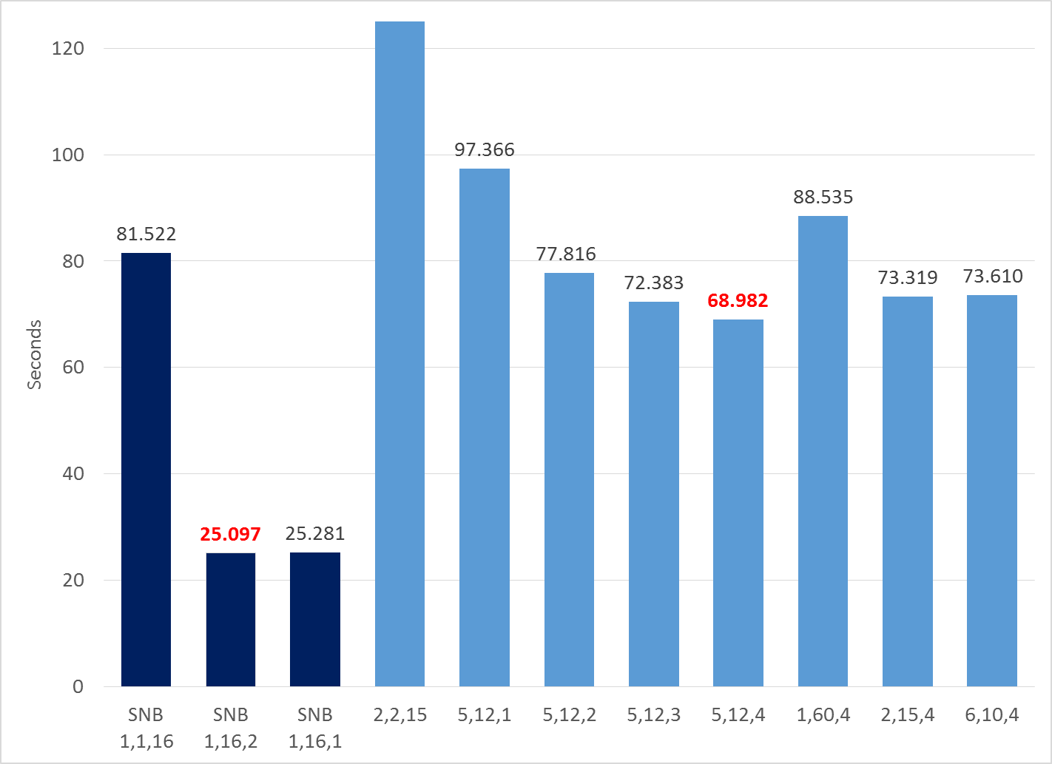
4km Workload (1X)
368.5
lower is better
npx,npy,nt
Best SNB: 18.8 GF/s on 16 cores (straight MPI)
Best KNC: 6.9 GF/s on 60 cores each 4-way threaded
Threading in NMMB is not scaling to large thread counts; main benefit is from latency hiding (concurrency) not parallelism
Factor of 2.75

Slide 11
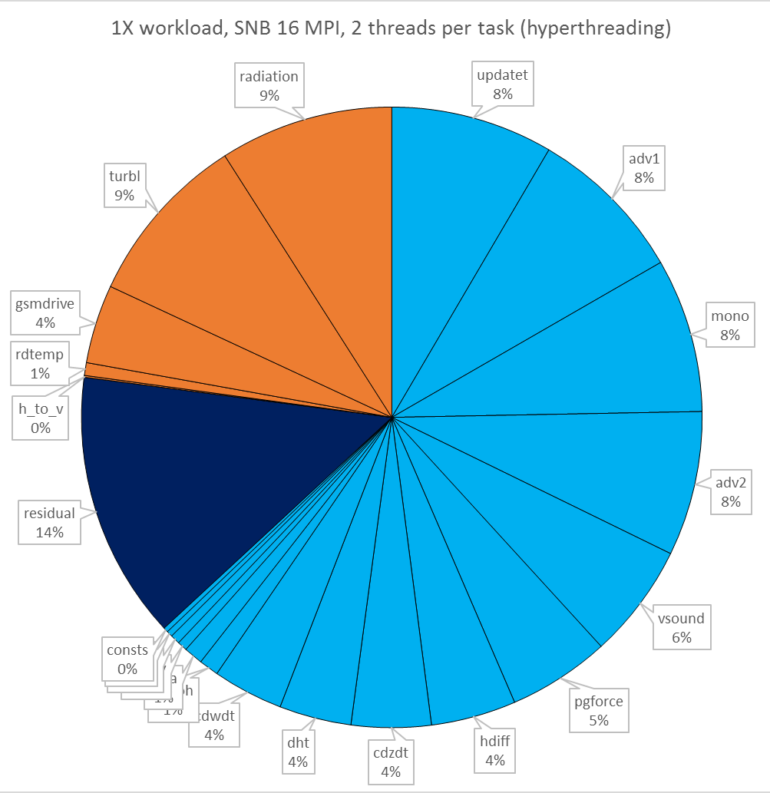
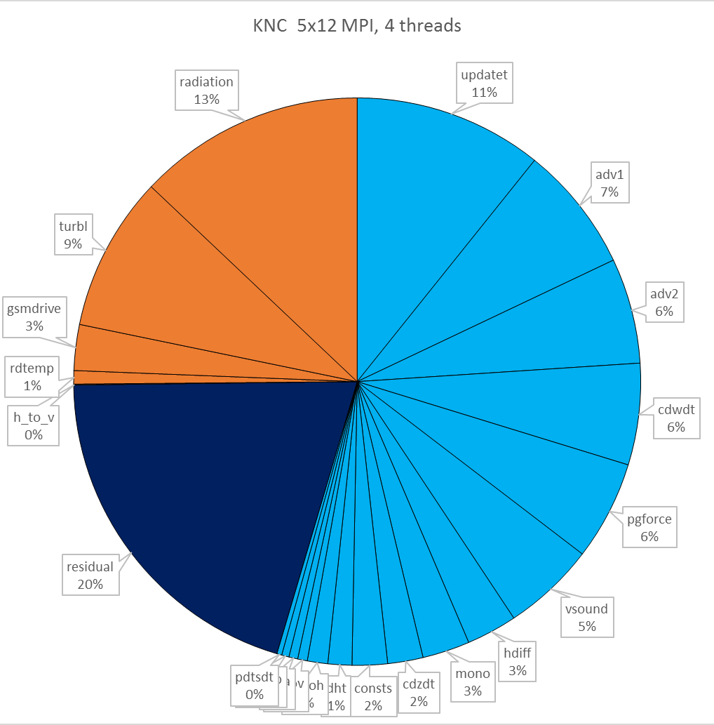
4km NMMB Workload (1X)
25.1 s/hour
18.8 GF/s
69.0 s/hour
6.9 GF/s
Notes:
From 4km workload 201311.xlsx in Folders\NEMS-NMMB
Op Count = 472.8668653 Gops/hour

Slide 12
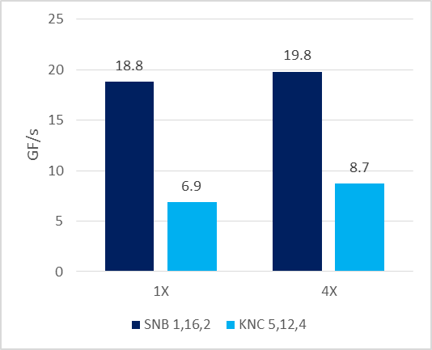
Effect of increasing workload size per node
Efficiency improves for both SNB (5%) and KNC (26%) with 4X workload
Dynamics benefits more from larger problem size than Physics
Residual also decreases
Penalty for KNC drops from smaller (2.7x) to larger (2.3x) workloads
higher is better

Slide 13
4km NMMB Workload (1X)
25.1 s/hour
18.8 GF/s
69.0 s/hour
6.9 GF/s
Notes:
From 4km workload 201311.xlsx in Folders\NEMS-NMMB
Op Count = 472.8668653 Gops/hour

Slide 14
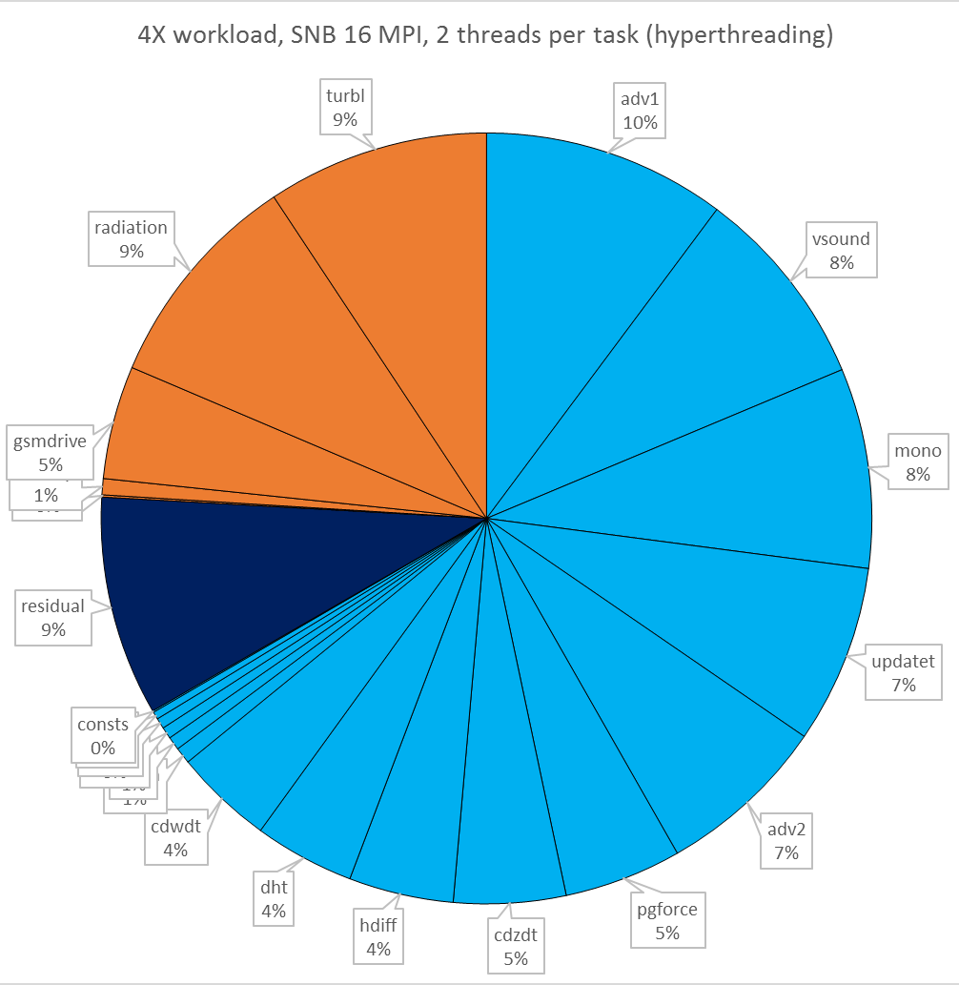
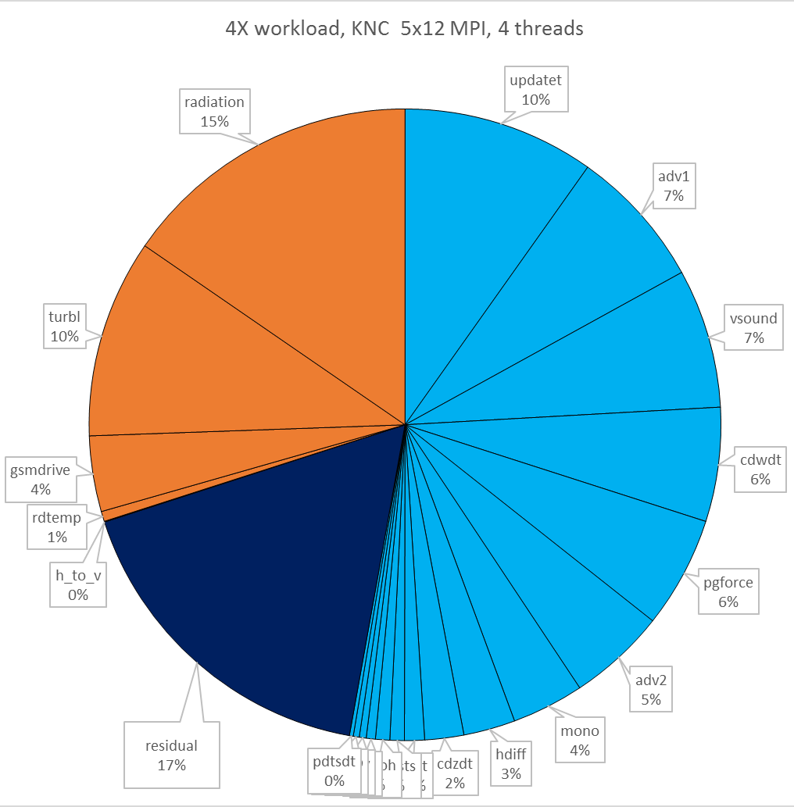
4km NMMB Workload (4X)
95.3 s/hour
19.8 GF/s
216.4 s/hour
8.7 GF/s
Notes:
From 4km workload 201311.xlsx in Folders\NEMS-NMMB

Slide 15
Current performance
KNC is factor of 2.3-2.7x slower than 2 sockets of SNB
Most NMMB parallelism is coming from MPI
MPI memory traffic and storage is unnecessary overhead
Threading is only helping up to 4-way for hiding memory latency
NMMB code needs to expose and exploit more thread parallelism
Continue with OpenMP work
Investigate Partitioned Global Address Space (PGAS)
Fine-grained parallelism (vectorization)
SWFLUX in RRTM and other physics modules need to expose and exploit dependency-free dimension

Slide 16
NMMB threading
Currently
OpenMP threading implemented at loop level
Based on dependency free dimensions: thread dimension may switch from horizontal to vertical depending on loop
Threading limited by outer loop extent
To optimize
Thread only over horizontal dimensions in physics
Collapse nested loops to increase available parallelism
Raise loops higher up the call tree around calls to physics
More work per loop body to amortize OpenMP overhead
Regularize looping
Implement tile-sized local arrays (todo)

Slide 17
NEMS/NMMB Solver
1 SUBROUTINE SOLVER_RUN
906 CALL HDIFF
... more dynamics ...
2101 physics: IF(INTEGER_DT>0)THEN
2180 !$OMP PARALLEL DO &
2182 chunk_loop1: DO ip = 1,((1+(ite-its+1)/CHUNK)*CHUNK)*(jte-jts+1),CHUNK
2376 CALL UPDATE_WATER(int_state%CW
2417 CALL READPCP(MYPE,MPI_COMM_COMP
2434 ENDDO chunk_loop1
2435 !$OMP END PARALLEL DO
2533 CALL RADIATION(NTIMESTEP_RAD
2600 CALL RDTEMP(NTIMESTEP,int_state%DT,JULDAY,JULYR,START_HOUR
2735 !$OMP PARALLEL DO &
2737 chunk_loop2: DO ip = 1,((1+(ite-its+1)/CHUNK)*CHUNK)*(jte-jts+1),CHUNK
2750 CALL TURBL(NTIMESTEP,int_state%DT,int_state%NPHS
2830 ENDDO chunk_loop2
2831 !$OMP END PARALLEL DO
2891 CALL H_TO_V_TEND(int_state%DVDT,int_state%DT,int_state%NPHS,LM
2997 !$OMP PARALLEL DO &
2999 chunk_loop2a: DO ip = 1,((1+(ite-its+1)/CHUNK)*CHUNK)*(jte-jts+1),CHUNK
3046 CALL CLTEND(ICLTEND,int_state%NPRECIP,int_state%T
3070 CALL CUCNVC(NTIMESTEP,int_state%DT,int_state%NPRECIP
3122 ENDDO chunk_loop2a
3123 !$OMP END PARALLEL DO
3193 CALL H_TO_V_TEND(int_state%DVDT,int_state%DT
3295 !$OMP PARALLEL DO &
3297 chunk_loop3: DO ip = 1,((1+(ite-its+1)/CHUNK)*CHUNK)*(jte-jts+1),CHUNK
3302 CALL GSMDRIVE(NTIMESTEP,int_state%DT
3345 CALL CLTEND(ICLTEND,int_state%NPRECIP,int_state%T
3389 ENDDO chunk_loop3
3390 !$OMP END PARALLEL DO
3530 CALL WRT_PCP(int_state%PREC
3538 ENDIF physics
3565 END SUBROUTINE SOLVER_RUN
Focusing on Physics for now
Dynamics already threaded (but 1D)

Slide 18
NEMS/NMMB Solver (tiling physics)
1 SUBROUTINE SOLVER_RUN
906 CALL HDIFF
... more dynamics ...
2101 physics: IF(INTEGER_DT>0)THEN
2180 !$OMP PARALLEL DO &
2182 chunk_loop1: DO ip = 1,((1+(ite-its+1)/CHUNK)*CHUNK)*(jte-jts+1),CHUNK
2376 CALL UPDATE_WATER(int_state%CW
2417 CALL READPCP(MYPE,MPI_COMM_COMP
2434 ENDDO chunk_loop1
2435 !$OMP END PARALLEL DO
2533 CALL RADIATION(NTIMESTEP_RAD
2600 CALL RDTEMP(NTIMESTEP,int_state%DT,JULDAY,JULYR,START_HOUR
2735 !$OMP PARALLEL DO &
2737 chunk_loop2: DO ip = 1,((1+(ite-its+1)/CHUNK)*CHUNK)*(jte-jts+1),CHUNK
2750 CALL TURBL(NTIMESTEP,int_state%DT,int_state%NPHS
2830 ENDDO chunk_loop2
2831 !$OMP END PARALLEL DO
2891 CALL H_TO_V_TEND(int_state%DVDT,int_state%DT,int_state%NPHS,LM
2997 !$OMP PARALLEL DO &
2999 chunk_loop2a: DO ip = 1,((1+(ite-its+1)/CHUNK)*CHUNK)*(jte-jts+1),CHUNK
3046 CALL CLTEND(ICLTEND,int_state%NPRECIP,int_state%T
3070 CALL CUCNVC(NTIMESTEP,int_state%DT,int_state%NPRECIP
3122 ENDDO chunk_loop2a
3123 !$OMP END PARALLEL DO
3193 CALL H_TO_V_TEND(int_state%DVDT,int_state%DT
3295 !$OMP PARALLEL DO &
3297 chunk_loop3: DO ip = 1,((1+(ite-its+1)/CHUNK)*CHUNK)*(jte-jts+1),CHUNK
3302 CALL GSMDRIVE(NTIMESTEP,int_state%DT
3345 CALL CLTEND(ICLTEND,int_state%NPRECIP,int_state%T
3389 ENDDO chunk_loop3
3390 !$OMP END PARALLEL DO
3530 CALL WRT_PCP(int_state%PREC
3538 ENDIF physics
3565 END SUBROUTINE SOLVER_RUN
Focusing on Physics for now
Dynamics already threaded (but 1D)
Tiles dimensioned CHUNK x 1
3200 tiles on 251x200 test domain
CHUNK defined @ compile time.
Will make vector length on Phi (16)
Will make long on Xeon
Routines in loops need to be tile-callable
Emphasize: this is not the final form

Slide 19
Exposing Vectorization in RRTM SW
Code structure inhibits vectorization
Column-wise: k-innermost computation called inside i,j outer loops with copy-in/copy-out to local k-arrays
Serial hotspot in k: SWFLUX – here the loops and stride-1 dimension is vertical (k) and there are serial dependencies – won’t vectorize!

Slide 20
Exposing Vectorization in RRTM SW
2602 SUBROUTINE SOLVER_RUN (GRID_COMP nmm/module_SOLVER_GRID_COMP.F90
5594 CALL RADIATION(NTIMESTEP_RAD
64 SUBROUTINE RADIATION(ITIMESTEP...
416 !$omp parallel private(nth,tid,i,j,k,jqs,jqe)
480 CALL RRTM(ITIMESTEP,DT_INT,JDAT nmm/module_RADIATION.F90
612 !$omp end parallel
93 SUBROUTINE RRTM (NTIMESTEP,DT_INT,JDAT phys/module_RA_RRTM.F90
LOOP over I and J with loop ranges computed in RADIATION driver and
passed in as JQS, JQE
908 call grrad_nmmb
466 subroutine grrad_nmmb phys/grrad_nmmb.f
This routine is written to be callable for an i-vector of adjacent
grid cells with static dimension IX and dynamic runlength IM.
1700 call swrad
324 subroutine swrad radsw_main.f
this routine is callable for a vector of points defined at runtime
by the argument NDAY and statically by IMAX. In practice these
are '1'.
616 lab_do_ipts : do ipts = 1, NDAY
within this loop everything is k-columns
965 call spcvrt
1547 subroutine spcvrt
1900 call swflux ( jb ) ! this is the big cost
1948 subroutine swflux ( ib )
2075 lab_do_jg : do jg = 1, ngt loop over all g-points in each band
2141 lab_do_ipa1 : do ipa = 1, 2 ! 1: clear-sky, 2, cloudy-sky
2143 do k = 1, NLAY this loop has vertical dependencies on k
2265 do k = NLAY, 1, -1 this loop has vertical dependencies on k
2307 do k = 1, NLAY this loop has vertical dependencies on k
2325 do k = NLAY, 2, -1 this loop has vertical dependencies on k
2257 enddo lab_do_ipa1 ! end do_ipa_loop
Code structure inhibits vectorization
Column-wise: k-innermost computation called inside i,j outer loops with copy-in/copy-out to local k-arrays
Serial hotspot in k: SWFLUX – here the loops and stride-1 dimension is vertical (k) and there are serial dependencies – won’t vectorize!

Slide 21
Exposing Vectorization in RRTM SW
Code structure inhibits vectorization
Column-wise: k-innermost computation called inside i,j outer loops with copy-in/copy-out to local k-arrays
Serial hotspot in k: SWFLUX – here the loops and stride-1 dimension is vertical (k) and there are serial dependencies – won’t vectorize!
Transformation
Add stride-1 index over adjacent columns to local arrays seen by SPCVRT on down to SWFLUX
DO k = 2, nk
A(k) = f(A(k-1))
ENDDO
DO k = 2, nk
DO i = 1, veclen
A(i,k) = f(A(i,k-1))
ENDDO
ENDDO
Fundamentally serial and non-vectorizable because of loop-carried dependence on k
Compiler will vectorize the i-loop

Slide 22
Exposing Vectorization in RRTM SW
Run-time overhead is minimal, since the routine is already doing copy-in/copy-out of local arrays
Vector dimension veclen can be defined to be:
Cache-aligned: avoids penalty for unaligned accesses and remainder code
Multiple of vector width: (16 single precision words)
Statically: compiler can use the information for optimizing
Working set size controllable
DO k = 2, nk
A(k) = f(A(k-1))
ENDDO
DO k = 2, nk
DO i = 1, veclen
A(i,k) = f(A(i,k-1))
ENDDO
ENDDO
Fundamentally serial and non-vectorizable because of loop-carried dependence on k
Compiler will vectorize the i-loop

Slide 23
RRTM SW
For GPU, essentially the same array index transformation ...
... except fine-grained parallel loop is the outer loop (implicit) over kernel invocations on threads
CUDA sketch for swrad
__global__ void swrad ( ... )
for ( k = 1 ; k < nk ; k++ ) {
A(tid,k) = f(A(tid,k-1))
}
DO k = 2, nk
A(k) = f(A(k-1))
ENDDO
DO k = 2, nk
DO i = 1, veclen
A(i,k) = f(A(i,k-1))
ENDDO
ENDDO
Fundamentally serial and non-vectorizable because of loop-carried dependence on k
Compiler will vectorize the i-loop

Slide 24
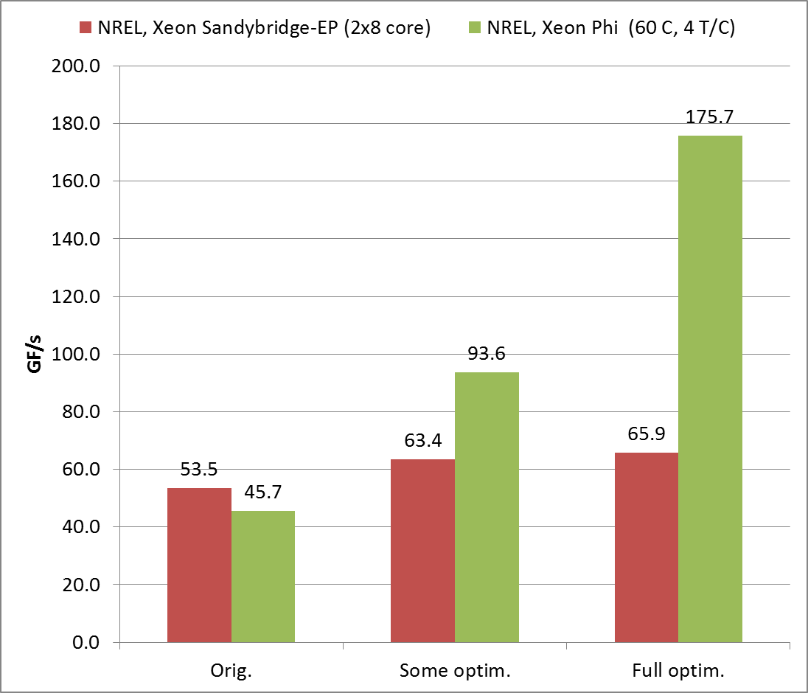
WSM5 Microphysics
Optimization for Xeon Phi
Collapse i and j loops over 16-cell chunks. More thread parallelism; smaller footprint per thread.
Compute using thread-private statically sized arrays. Improve vectorization.
Fuse loops, combine/eliminate temporaries to reduce footprint from 100KB  60KB thread. More threads/core, hide memory latency.
Higher is better
Effort optimizing for Phi benefits host
Notes:
Reducing the memory footprint of each thread from 100 -> 60 KB/thread

Slide 25
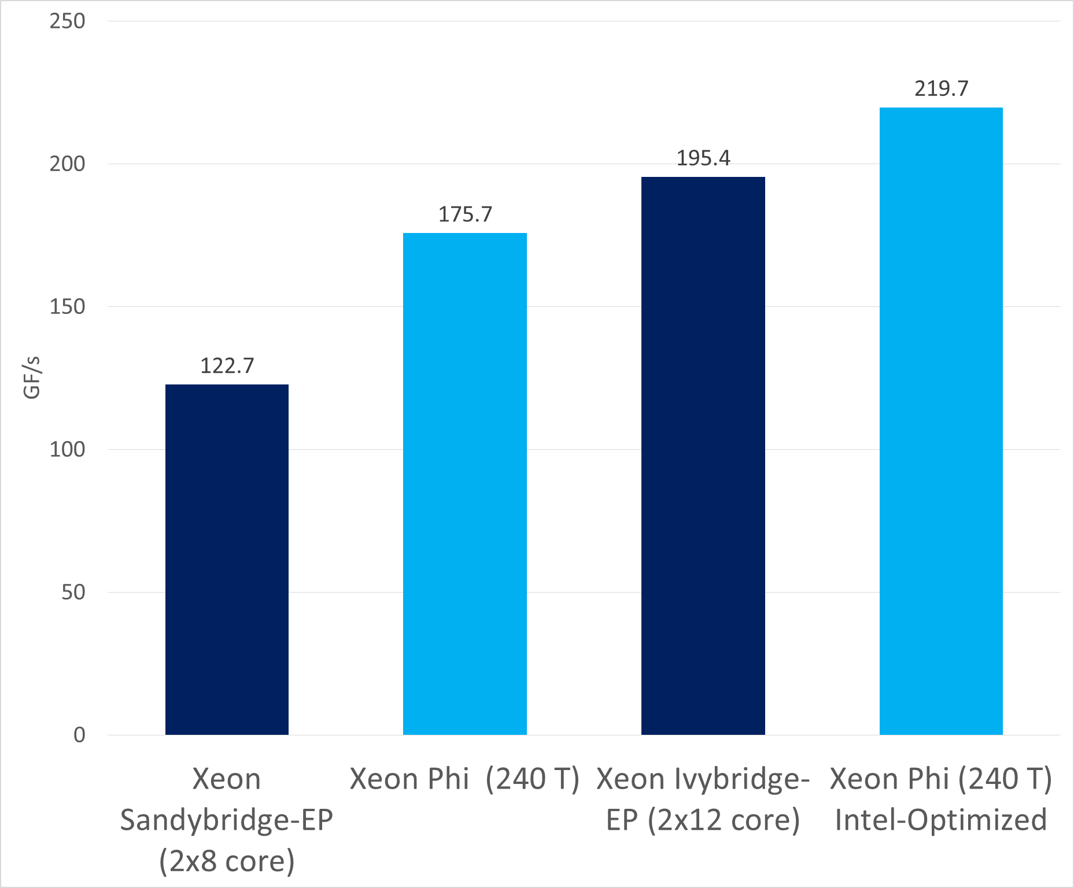
WSM5 Microphysics
Optimization for Xeon Phi
Collapse i and j loops over 16-cell chunks. More thread parallelism; smaller footprint per thread.
Compute using thread-private statically sized arrays. Improve vectorization.
Fuse loops, combine/eliminate temporaries to reduce footprint from 100KB  60KB thread. More threads/core, hide memory latency.
Higher is better
Notes:
Reducing the memory footprint of each thread from 100 -> 60 KB/thread

Slide 26
Summarizing status and going forward
Whole NMMB code (including ESMF and libraries) is ported to fine-grained architecture and optimization work is underway
Increasing concurrency, vectorization, and locality will improve performance on host processors too
Establish best practices for NCEP application readiness for accelerators in the next few years

Slide 27
Acknowledgements
NOAA
Tom Black, Ratko Vasic
Tom Henderson, Jim Rosinski
TACC
Bill Barth
Intel Corp.
Michael Greenfield
Lawrence Meadows
Alexander Knyazev
Indraneil Gokhale
Ruchira Sasanka
U. Wisconsin/SSEC
Jarno Mielikainen
Bormin Huang
U. Colorado
Jeremy Siek, Liz Jessup
NREL
Jim Albin
NCAR
Dave Gill, Jimy Dudhia, Wei Wang

Slide 29
Call and loop structure, RRTM
2602 SUBROUTINE SOLVER_RUN (GRID_COMP nmm/module_SOLVER_GRID_COMP.F90
5594 CALL RADIATION(NTIMESTEP_RAD
64 SUBROUTINE RADIATION(ITIMESTEP...
416 !$omp parallel private(nth,tid,i,j,k,jqs,jqe)
480 CALL RRTM(ITIMESTEP,DT_INT,JDAT nmm/module_RADIATION.F90
612 !$omp end parallel
93 SUBROUTINE RRTM (NTIMESTEP,DT_INT,JDAT phys/module_RA_RRTM.F90
LOOP over I and J with loop ranges computed in RADIATION driver and
passed in as JQS, JQE
908 call grrad_nmmb
466 subroutine grrad_nmmb phys/grrad_nmmb.f
This routine is written to be callable for an i-vector of adjacent
grid cells with static dimension IX and dynamic runlength IM.
1700 call swrad
324 subroutine swrad radsw_main.f
this routine is callable for a vector of points defined at runtime
by the argument NDAY and statically by IMAX. In practice these
are '1'.
616 lab_do_ipts : do ipts = 1, NDAY
within this loop everything is k-columns
965 call spcvrt
1547 subroutine spcvrt
1900 call swflux ( jb ) ! this is the big cost
1948 subroutine swflux ( ib )
2075 lab_do_jg : do jg = 1, ngt loop over all g-points in each band
2141 lab_do_ipa1 : do ipa = 1, 2 ! 1: clear-sky, 2, cloudy-sky
2143 do k = 1, NLAY this loop has vertical dependencies on k
2265 do k = NLAY, 1, -1 this loop has vertical dependencies on k
2307 do k = 1, NLAY this loop has vertical dependencies on k
2325 do k = NLAY, 2, -1 this loop has vertical dependencies on k
2257 enddo lab_do_ipa1 ! end do_ipa_loop

